Slide 1
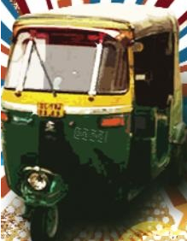
Indie-Go
STREET FOOD OF INDIA

Slide 2
Indie-Go
STREET FOOD OF INDIA
Indie-Go
STREET FOOD OF INDIA

